Slide 1
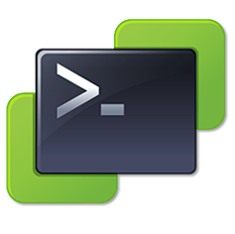
VMware PowerCLI
Introduction, Performace Tweaks and Specials

Slide 2

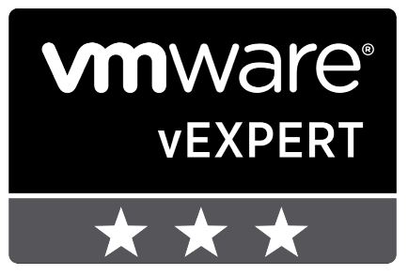

Speaker Introduction
Web: mycloudrevolution.com
Twitter: @vMarkus_K
Work: QSC AG (Hamburg)

Slide 3
Table of Content
Introduction to VMware PowerCLI
Demo
Performance Tweaks
PowerCLI Special
VM IDs
Q&A

Slide 4
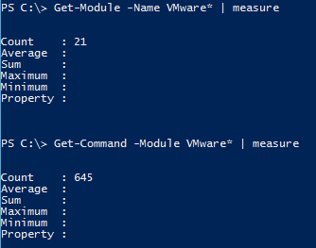

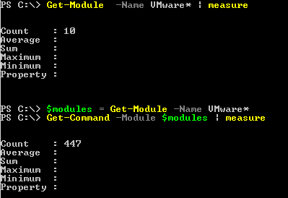
Introduction PowerShell vs. PowerShell Core

Slide 5

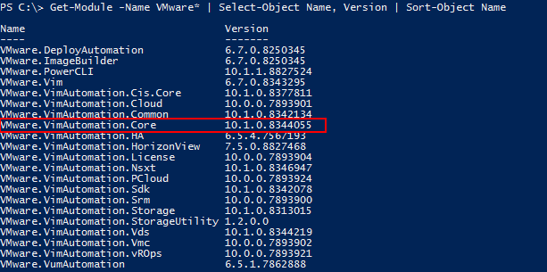


Introduction Modules
The Core-Module is for VMware vSphere

Slide 6



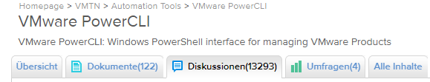
Introduction Community
PowerVRNI
PowerNSX (Core)
PowerVRA / PowerVRO

Slide 7
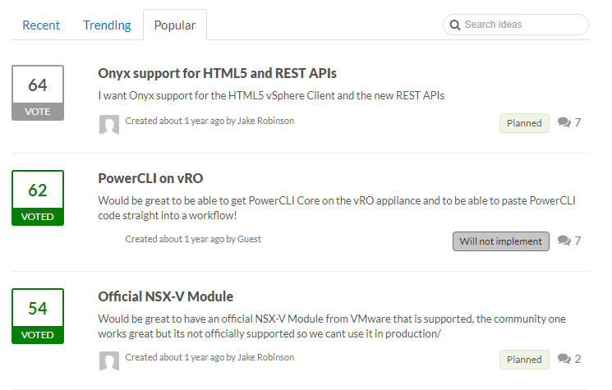
Introduction Community
https://powercli.ideas.aha.io/

Slide 8
Demo Basics
Load Module
Connect vCenter or ESXi Host
[Clone Lab VMs]
# Init ## Import VMware Modules
Get-Module -Name VMware* -ListAvailable | Import-Module
## Connect vCenter
Connect-VIServer vcenter-01.lab.local
## Prepare VMs
$sourceVMName = "test"
For ($i=1; $i -le 20; $i++) {
$newVMName = [String]($sourceVMName + $i)
New-VM -Name $newVMName -VM $sourceVMName -VMHost "esxi-01.lab.local" -Datastore "vol_vmware_01" -DiskStorageFormat Thin
}

Slide 9
Demo Performance Tweaks
Methods!
Get-VM vs. Get-View
# Perf - Methoden / Get-View mit Filter
## Init Array of VMs
$VMs = Get-VM
## Where-Object Cmdlet
Measure-Command { $VMs | Where-Object {$_.Name -eq "test"} }
## Where Methode
Measure-Command { $VMs.Where({$_.Name -eq "test"}) }
## Where Split
$VMsOn, $VMsOff = $VMs.Where({$_.PowerState -eq "PoweredOn"}, "Split")
$VMsOn.Count
$VMsOff.Count
## Get-View mit Filter gegen Get-VM mit Where-Object
Measure-Command {Get-VM -Name "test" | fl}
Measure-Command {Get-View -ViewType VirtualMachine -Filter @{Name="^test"} | fl}

Slide 10
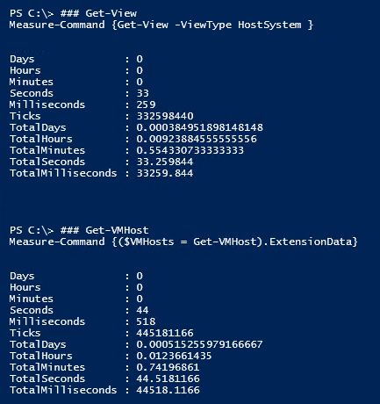
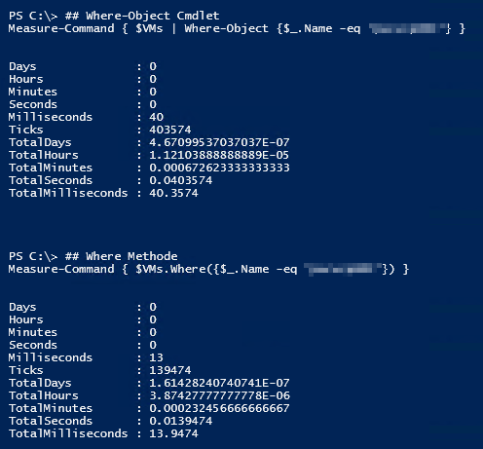
Demo Performance Tweaks – Results in larger scale
Test with 227 Hosts / 2551 VMs

Slide 11
Demo PowerCLI Special - PSDrive to VMware Datastore
Mount VMware Datastore as a PSDrive
[String]$LocalPath = "C:\temp\dummy.txt"
[String]$TempDatastoreName = "*local"
[Array]$VMhosts = Get-VMHost
$VMhosts.ForEach({
$Datastore = $_| Get-Datastore -Name $TempDatastoreName
$DatastoreDriveName = "HostStore_" + $_.Name.Split(".")[0]
$Datastore | New-DatastoreDrive -Name $DatastoreDriveName | Out-Null
Copy-DatastoreItem -Item $LocalPath -Destination $($DatastoreDriveName + ":\") -Force:$true -Confirm:$false
Remove-PSDrive -Name $DatastoreDriveName
})

Slide 12
Demo PowerCLI Special – ESXCLI -V2
Example: Patch installation
Native PowerCLI Cmdlet does only upgrade packages
ESXCLI can do up- and downgrade of packages
# ESXCLI -V2 $VMHost = $VMHosts | select -First 1
$Datastore = $VMHost | Get-Datastore -Name $TempDatastoreName
$HostPath = $Datastore.ExtensionData.Info.Url.remove(0,5) + $LocalPath.Split("\")[-1] ## Install-VMhost
Install-VMHostPatch -VMHost $VMHost -HostPath $HostPath ## ESXCLI V2
$esxcli2 = Get-ESXCLI -VMHost $VMhost -V2 ### List
$esxcli2.software.vib.list.Invoke() | FT -AutoSize ### Install
$CreateArgs = $esxcli2.software.vib.install.CreateArgs()
$CreateArgs.depot = $HostPath
$InstallResponse = $esxcli2.software.vib.install.Invoke($CreateArgs)

Slide 13
Demo PowerCLI Special – Invoke-VMScript
Enhanced: Invoke-VMScriptPlus V2 (http://www.lucd.info/2018/08/05/invoke-vmscriptplus-v2/)
Multi-Line Scripts
More Script-Types
$Pass = ConvertTo-SecureString 'Passw0rd!' -AsPlainText -Force
$sInvP = @{
VM = 'PhotonOS'
ScriptType = 'Bash'
ScriptText = $code
GuestOSType = 'Linux'
GuestUser = 'root'
GuestPassword = $Pass
}
Invoke-VMScriptPlus @sInvP

Slide 14
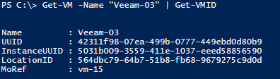
Demo VM IDs – Basics
UUID
uuid.bios / Generated by ESXi Host / Known by Guest OS as BIOS UUID
InstanceUUID
vc.uuid / Generated by vCenter
LocationsID
uuid.location / Hash of VMX File and ESXi UUID / vCenter needs this to idenfy third party changes to the VM
MoRef
Managed Object Reference / Generated by vCenter / Used by MOB, APIs and vCenter
Get-VM -Name "Veeam-03" | Get-VMID

Slide 15
Demo VM IDs – Identify Guest OS
Match Guest OS to vSphere VM
$sInvP = @{
VM = 'Veeam-03'
ScriptType = 'PowerShell'
GuestOSType = 'Windows'
ScriptText = $code
GuestCredential = $cred
}
Remove-Variable UUIDwin, UUIDreturn -ErrorAction SilentlyContinue
$UUIDreturn = Invoke-VMScriptPlus @sInvP
[String]$UUIDwin = $UUIDreturn.ScriptOutput
Convert-UUID -UUIDwin $UUIDwin
Get-VM -Name "Veeam-03" | Get-VMID | select UUID

Slide 16

Q&A

